Slide 1
Programming Fundamentals
By
Shazmeen Batool

Slide 2
Previous Lecture
Recursion

Slide 3
Today’s Lecture
Abstract Data Type
Structures
Accessing Elements of Structures

Slide 4
Abstract Data Types
Abstract data types (ADTs) are data types created by the programmer.
ADTs have their own range (or domain) of data and their own sets of operations that may be performed on them.
An abstract data type (ADT) is a data type created by the programmer and is composed of one or more primitive data types.

Slide 5
Structure
C++ allows you to group several variables together into a single item known as a structure.
So far you’ve written programs that keep data in individual variables.
If you need to group items together, C++ allows you to create arrays. The limitation of arrays, however, is that all the elements must be of the same data type.
Sometimes a relationship exists between items of different types.

Slide 6
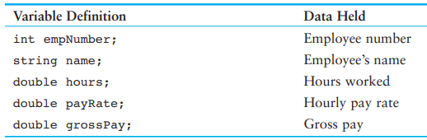
Structure
For example, a payroll system might keep the variables shown below

Slide 7
Structure
These variables hold data for a single employee
Their definition statements, though, do not make it clear that they belong together. To create a relationship between variables, C++ gives you the ability to package them together into a structure.

Slide 8
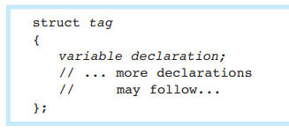
Creating Structure
Before a structure can be used, it must be declared.
Here is the general format of a structure declaration:

Slide 9
Creating Structure
The tag is the name of the structure.
It is used as a data type.
The variable declarations that appear inside the braces declare members of the structure.

Slide 10
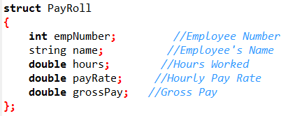
Example
Here is an example of a structure declaration that holds the payroll data

Slide 11
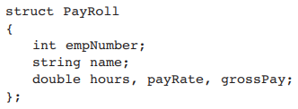
Creating Structure
Notice that a semicolon is required after the closing brace of the structure declaration.
The structure declaration shown contains three double members, each declared on a separate line. The three could also have been declared on the same line, as
Many programmers prefer to place each member declaration on a separate line, however, for increased readability.

Slide 12
Defining Structure
It’s important to note that the structure declaration in our example does not define a variable. It simply tells the compiler what a PayRoll structure is made of.
In essence, it creates a new data type named PayRoll.
You can define variables of this type with simple definition statements, just as you would with any other data type.

Slide 13
Defining Structure
For example, the following statement defines a variable named deptHead :
PayRoll deptHead;
The data type of deptHead is the PayRoll structure. The structure tag, PayRoll , is listed before the variable name just as the word int or double would be listed to define variables of those types.

Slide 14
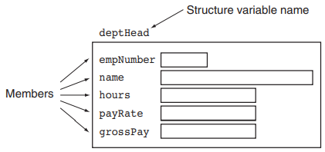
Defining Structure
Payroll Structure

Slide 15
Defining Structure
Just as it’s possible to define multiple int or double variables, it’s possible to define multiple structure variables in a program.
The following statement defines three PayRoll variables:
PayRoll deptHead, foreman, associate;

Slide 16
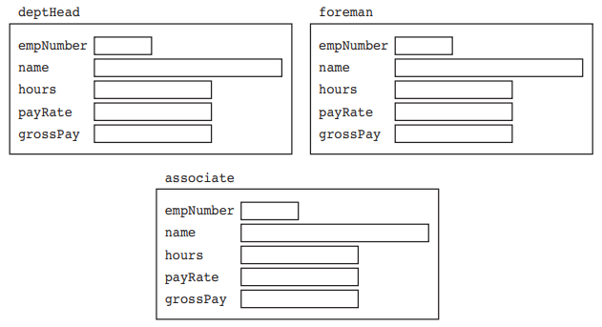
Defining Structure

Slide 17
Defining Structure
Each of the variables defined in this example is a separate instance of the PayRoll structure and contains its own members.
An instance of a structure is a variable that exists in memory.
It contains within it all the members described in the structure declaration.
Although the structure variables in the example are separate, each contains members with the same name.

Slide 18
Structure
In review, there are typically two steps to implementing structures in a program:
Create the structure declaration. This establishes the tag (or name) of the structure and a list of items that are members.
Define variables (or instances) of the structure and use them in the program to hold data.

Slide 19
Accessing the Elements of Structure
The dot operator (.) allows you to access structure members in a program.
C++ provides the dot operator (a period) to access the individual members of a structure.
Using our example of deptHead as a PayRoll structure variable, the following statement demonstrates how to access the empNumber member:
deptHead.empNumber = 475;

Slide 20
Accessing the Elements of Structure
deptHead.empNumber = 475;
In this statement, the number 475 is assigned to the empNumber member of deptHead .
The dot operator connects the name of the member variable with the name of the structure variable it belongs to.

Slide 21
Accessing the Elements of Structure
The following statements assign values to the empNumber members of the deptHead , foreman , and associate structure variables:
deptHead.empNumber = 475;
foreman.empNumber = 897;
associate.empNumber = 729;

Slide 22
Next Lecture
Comparing Structures Variables
Array as a Member of Structure
Array of Structures

